Slide 1

Transportation in Chicago
So many options…

Slide 2
Chicago Transportation System - Overview
Residents and visitors of Chicago have many options available to them to get from point A to point B. As a mini project, our team leveraged data captured and provided by the City of Chicago to determine how Taxi Usage has changed over the years. Factors that impacted the usage of Taxi Services are cost of public transportation, the introduction of Ride Shares via Uber, Lyft as well as Bike and Scooter Share options. Future projects related to Chicago’s Strategy on Transportation should take into consideration the following options that are currently available within Chicago proper and surrounding suburbs.
Operator(s):
Chicago Subway and Elevated Train Lines
Chicago Transit Authority
Metra Railroads
Uber Ride Share
Lift
Taxi Services
Bike and Scoter Share
Daily ridership: More than 10 million
Notes:
QuickStarter has created an outline to help you get started on your presentation. Some slides include information here in the notes to provide additional topics for you to research.
Summary:
The transportation system of New York City is a network of complex infrastructural systems. New York City, being the most populous city in the United States, has a transportation system which includes one of the largest subway systems in the world; the world's first mechanically ventilated vehicular tunnel; and an aerial tramway. New York City's airport system, which includes John F. Kennedy International Airport, LaGuardia Airport, Newark Liberty International Airport, Stewart Airport and a few smaller facilities, is one of the largest in the world. New York City is also home to an extensive bus system in each of the five boroughs, and numerous taxis throughout the city.

Slide 3

Taxi Services
Taxi Services Usage
2015 to 2017
Fare by Community Area
Taxi Usage Impact Ride Share

Slide 4
Fare Prices by Area

Slide 5
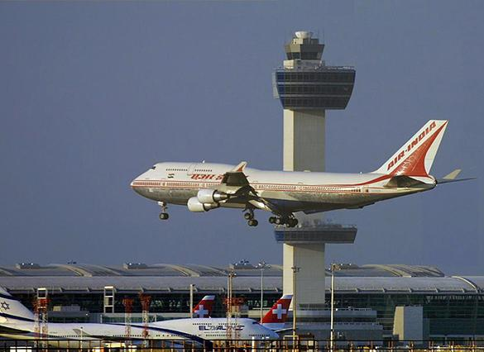
Taxi Usage to Airports
Midway
OHare

Slide 6
Data Source and Approach
Data Source:
City of Chicago
Data Analysis Approach
Limited data to Community area for 2015, 2016 and 2017.

Slide 7
Data Team
Kamil
Rupal
Vineeth
Suhail
Nilay

